Slide 1

The Victors
TAQDEER Dataset
Capstone Project

Slide 2
The Victors
Team Member：
Mashhor
Waleed
Saad
Nawaf
Mohamad
Sami

Slide 3
Outline
01
TAQDEER
02
Project Specification
03
Into To Dataset
04
05
Exploratory Data Analysis
06
Preprocessing
Machine Learning
07
08
Summary
Future Work

Slide 4
01
TAQDEER

Slide 5

What is TAQDEER
Taqdeer is an integrated system for managing, operating, and organizing vehicle damage assessments electronically and professionally.
Taqdeer system works on the governance of procedures and technical touch with all parties concerned with vehicle damage assessment.

Slide 6

What is TAQDEER

Slide 7
02
Project Specification

Slide 8
Project Specification
About
Purpose
Machine learning project uses past vehicle damage assessments to predict future vehicle damage assessments according to car information.
Automate the vehicle damage assessment process to increase productivity without reducing the assessment accuracy.
01
02

Slide 9



Project Objectives
Automation
Automate the accident damage assessment process.
Productivity
Reduce the assessment process time, to achieve higher productivity.
Accuracy
Make highly Accurate assessments by the machine learning model.

Slide 10

2030 Vision
Digital Transformation
Digital transformation is one of the main targets of the 2030 vision. Our project aims to achieve digital transformation in the field of vehicle damage assessment by automating the assessment process based on machine learning without the need for assessment experts.

Slide 11
03
Introduction to the Dataset

Slide 12
Dataset Sample
Part Name | Payment Type | Total Cost | Spare Part Cost | Assessment Cost | Car Color | Manufacture Year | Car Model | Car Brand | Close Time | Registration Time | City | Area
جنط كروم مقاس 18 عدد 1 | عن طريق شركة التأمين | 13326 | 5763 | 7563 | ذهبي | 2016 | توروس | فورد | 2018-11-04 15:44:00 | 2018-11-04 14:04:55.33 | الرياض | صناعية العاصمة
عضمة صدام امامي يمين | عن طريق شركة التأمين | 898 | 99 | 799 | رمادي | 2013 | كامري | تويوتا | 2018-06-12 15:03:00 | 2018-06-12 14:49:24.967 | الرياض | العروبة
صدام خلفي | عن طريق شركة التأمين | 2300 | 400 | 1900 | فضي | 2012 | اكسنت | هيونداي | 2018-07-03 08:34:00 | 2018-07-03 08:20:46.043 | الرياض | الصناعية الجديدة

Slide 13
Columns Description

Slide 14
Columns Description
Area
CarModel
01
06
Taqdeer Centre Area.
The name of the car.
TotalCost
11
City
ManufactureYear
Assessment Cost + Spare Part Cost.
02
07
Where did the accident happen.
The year when the car manufactured.
RegistrationTime
CarColor
PaymentType
03
08
12
The time when the assessment started.
The color of the car.
How did the customer pay?
By Insurance Company or Through POS.
CloseTime
AssessmentCost
04
09
The time when the assessment closed.
The cost of hand work.
PartName
13
CarBrand
SparePartCost
The name of the damaged part.
05
10
Car manufacture company.
The cost of damaged parts.

Slide 15
Challenges With the Dataset
More Than 1M Records
Arabic Spelling Issues
Informal Arabic
01
03
05
02
04
06
Mixed Inputs
Parts Standardization
Translation to English

Slide 16
04
Preprocessing
The death zone

Slide 17
Mixed inputs
All data consistent with the columns' titles.
Problem
Solution
Result
Car Model | Car Brand | City | Area
توروس | الرياض | فورد | صناعية العاصمة
العروبة | تويوتا | كامري | الرياض
الرياض | اكسنت | هيونداي | الصناعية الجديدة
1- Drop rows with null values.
2- Drop the rest of the mixed columns.

Slide 18
Arabic Spelling Issues
Before: 80K PartName unique value
Problem
Solution
Result
ربلة
ربله
آسطب
اسطب
صدام(امامي
هـ → ة
ا → أ
ا → إ
ا → آ
Special char → _
ربله
ربله
اسطب
اسطب
صدام امامي
After: 60K PartName unique value

Slide 19
Parts Standardization
Before: 60K PartName unique value
Problem
Solution
Result
حساس
حساسصدام
احساس
حساسا
حاس
Similarity function:
If two elements are similar to each other by more than 75% → put them in one category
حساس
حساس
حساس
حساس
حساس
After: 2K PartName unique value

Slide 20
Parts Standardization cont.
Problem
Solution
Result
1- Choose the first 60 categories.
2- The remaining → Others
3- Clustering the related categories manually.
Unique values = 2K
(we have 2k categories)
Unique values = 32
(we have 32 categories)

Slide 21
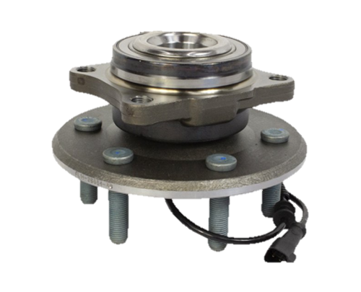
Informal Arabic
Problem
Solution
Result
فلنجة
1- Google the Arabic word to know what is the part ☹

Slide 22
Translation to English
PartName column
Problem
Solution
Result
1- Image search to know the English word of the part.
2- Map every Arabic name with the equivalent English name.
Rotor

Slide 23
Translation to English Cont.
Rest columns
Problem
Solution
Result
لكزس
بنتلي
مرسيدس
1- Use google translate API.
Lexus
Bingle
Mercedes

Slide 24
Translation to English cont.
False translations
Bentley
Problem
Solution
Result
bingle
1- Print the mapping from English to Arabic then check the correctness of translation.

Slide 25
Combine Common Rows
250 k rows
And the PartName become PartList
Problem
Solution
Result
Iterate through the rows and make sure if the row is equal in all columns except the part and put a new key for them
There are many rows with the same value except for the part name column

Slide 26
Combine Common Rows cont.
Before Combine
Part Name | Payment Type | Total Cost | Spare Part Cost | Assessment Cost | Car Color | Manufacture Year | Car Model | Car Brand | Close Time | Registration Time | City | Area
جنط | عن طريق شركة التأمين | 13326 | 5763 | 7563 | ذهبي | 2016 | توروس | فورد | 2018-11-04 15:44:00 | 2018-11-04 14:04:55.33 | الرياض | صناعية العاصمة
صدام | عن طريق شركة التأمين | 13326 | 5763 | 7563 | ذهبي | 2016 | توروس | فورد | 2018-11-04 15:44:00 | 2018-11-04 14:04:55.33 | الرياض | صناعية العاصمة
صدام | عن طريق شركة التأمين | 13326 | 5763 | 7563 | ذهبي | 2016 | توروس | فورد | 2018-11-04 15:44:00 | 2018-11-04 14:04:55.33 | الرياض | صناعية العاصمة
After Combine
Part List | Payment Type | Total Cost | Spare Part Cost | Assessment Cost | Car Color | Manufacture Year | Car Model | Car Brand | Close Time | Registration Time | City | Area
]صدام, جنط[ | عن طريق شركة التأمين | 13326 | 5763 | 7563 | ذهبي | 2016 | توروس | فورد | 2018-11-04 15:44:00 | 2018-11-04 14:04:55.33 | الرياض | صناعية العاصمة

Slide 27
05
Exploratory Data Analysis

Slide 28
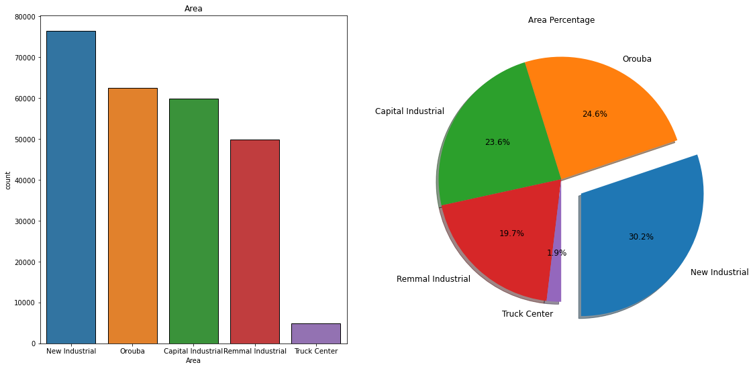
01
New Industrial is the most commonly visited center in Riyadh.

Slide 29
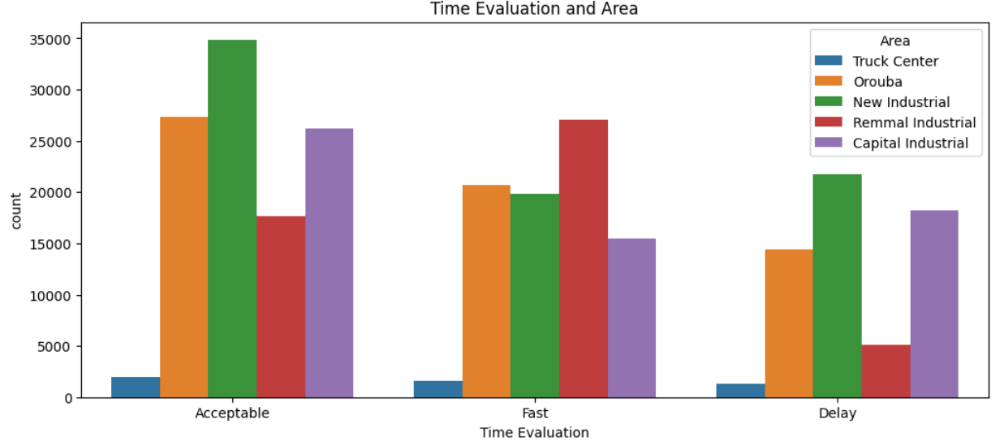
02
The Remmal Industrial is the Fastest Time Evaluation between the Areas

Slide 30
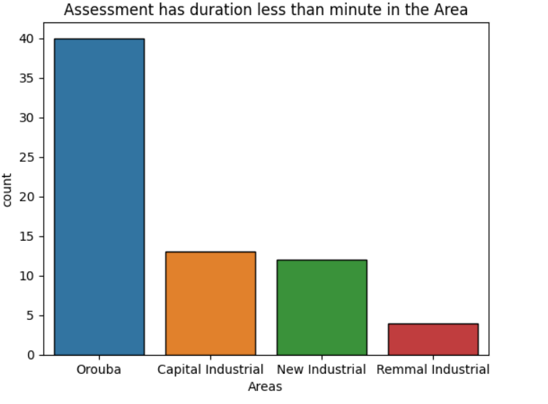
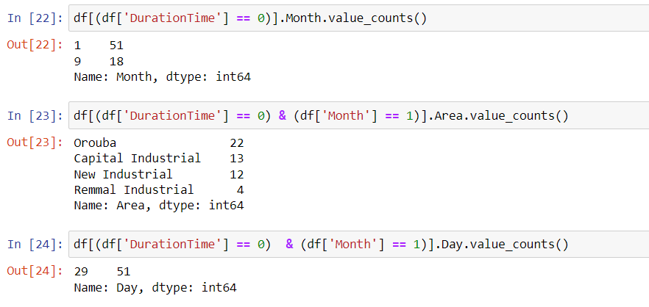
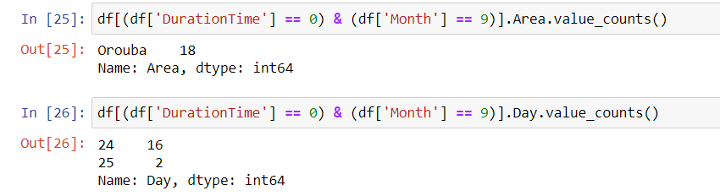
03

Slide 31
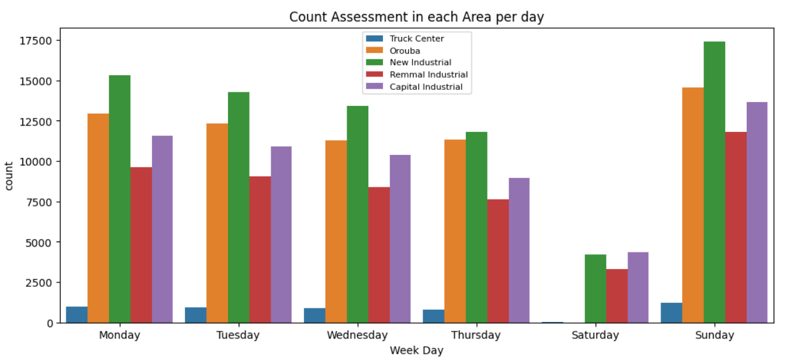
04
We can observe that Saturday is the least crowded, and it can be noted that the Orouba Center does not operate on Saturday.

Slide 32
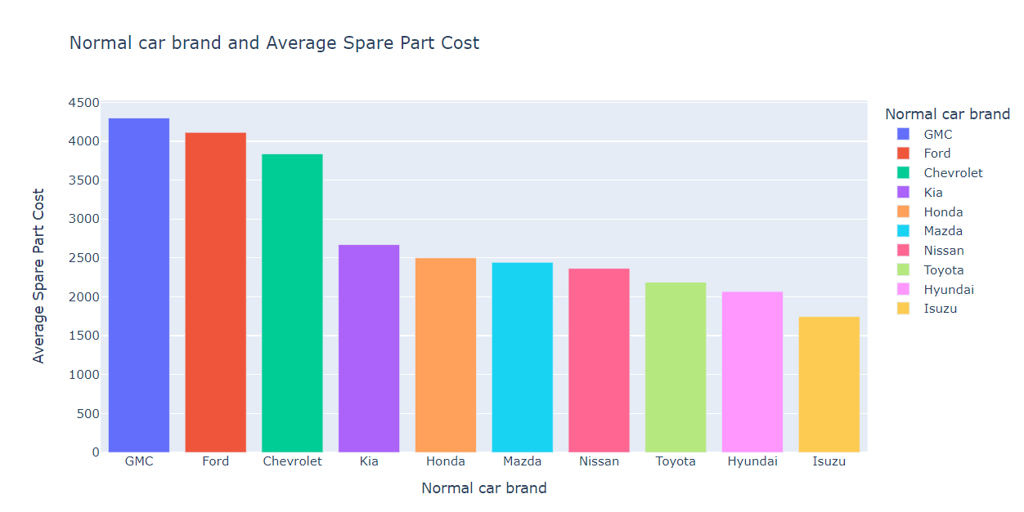
05
We can observe that GMC is the highest Spare part cost, and Isuzu is the lowest one.

Slide 33
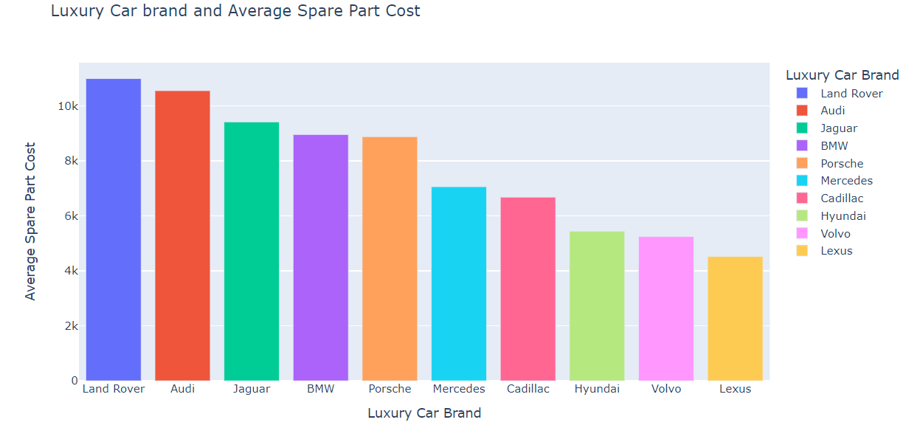
06
We can observe that Land Rover is the highest Spare part cost, and the Lexus is the lowest one.

Slide 34
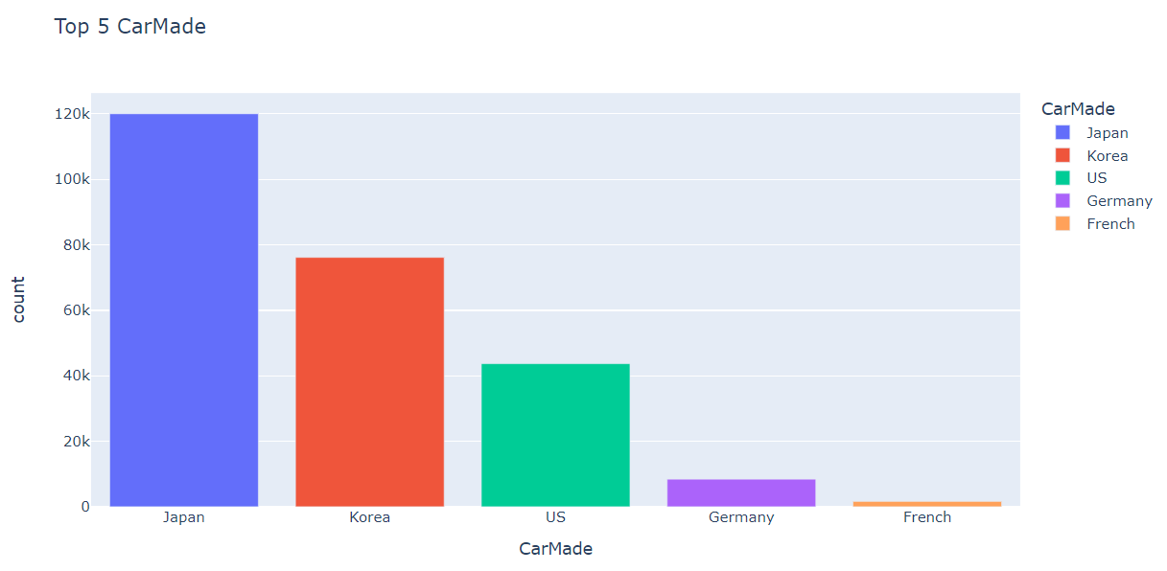
07
We can observe that Japanese cars is the most cars use in Riyadh

Slide 35
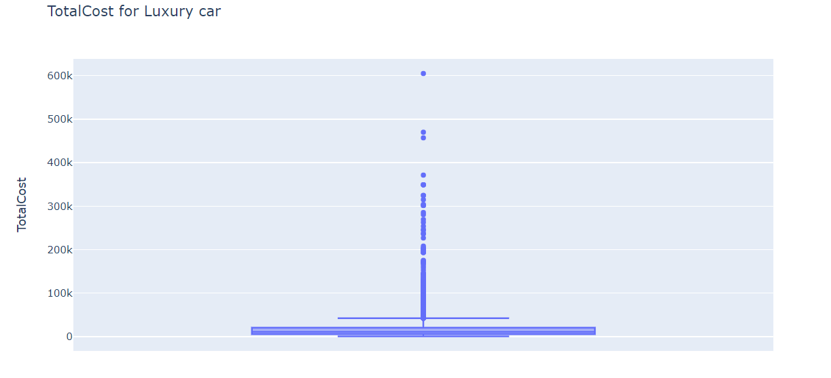
08
- The maximum total cost for a luxury car is 605.02K
- Any cost above 42236 is the outlier
- The minimum total cost for a luxury car is 525
- The median is 10.8K

Slide 36
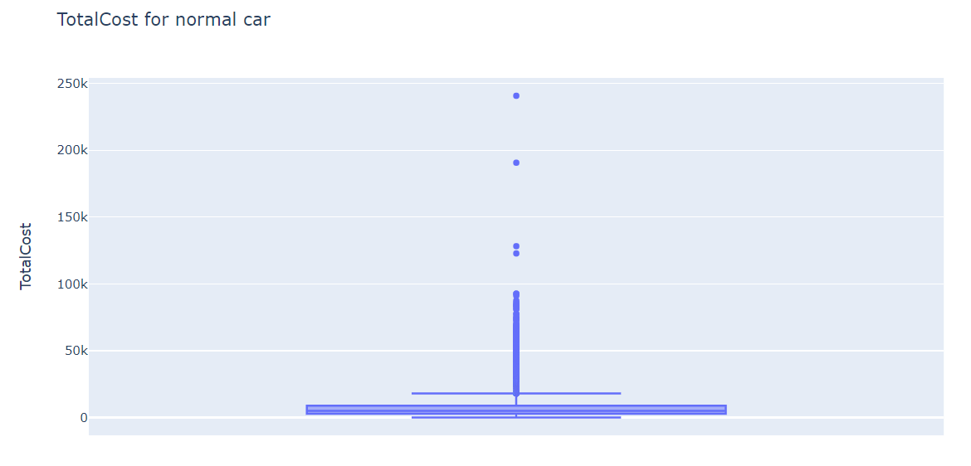
09
- The maximum total cost for a normal car is 240.8K
- Any cost above 18.03K is the outlier
-The median is 4972

Slide 37
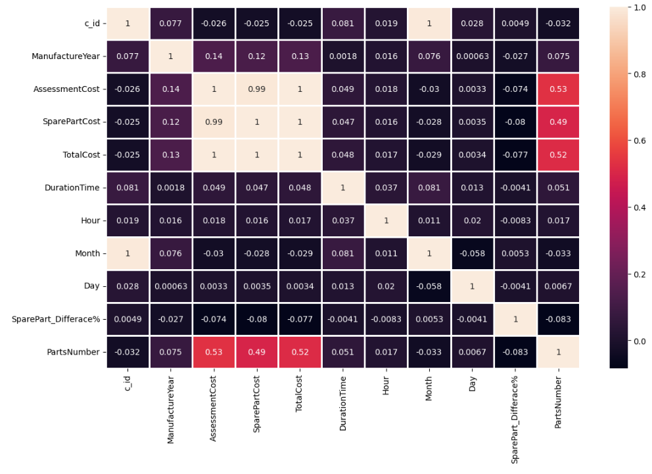
10

Slide 38
Dashboard

Slide 39
06
Machine Learning

Slide 40
Regression Model
XGBoost Regressor
Baseline
Training Set
Testing Set
MAE: 2000
Accuracy: 83%
MAE: 2173
Accuracy 72%
MAE: 5000
The difference between the training accuracy and testing accuracy is: 10%
The model in general is (Good)

Slide 41
Classification Model
XGBoost Classifier
Baseline
Training Set
Testing Set
Accuracy: 49%
Accuracy: 76%
Accuracy 74%
The difference between the training accuracy and testing accuracy is: 1.8%
The model in general is (Great)

Slide 42
07
Summary

Slide 43
Summary
We think that our results are so high considering the many challenges in the data set.
We also think that we can build a real automotive system that can predict vehicles damage assessments with very high accuracy.

Slide 44
08
Future Work

Slide 45
Future Work
Testing the models in the real-world life
Improving the accuracy of the models
Develop our models
1
3
5
2
2
4
6
Contact Taqdeer to present our work
Training the models with more new data from Taqdeer.
Publish our system to use in Taqdeer centers

Slide 46
The Victors
Thank You For Listening
Any Questions?

